Slide 1



Question &Answer system
Meet Our Team (Group -10)
Subhamita Halder (23CS8192)
Syamantak Banerjee (23CS8193)
Bejawada Sesha Durga Sagar (23CS8194)
Shaswat Ranjan (23CS8195)
Kunal Singh Munda (23CS8196)
Aditya Pratap Singh (23CS8197)
Ritesh Kumar Yadav (23CS8198)
Pranjal Singh (23CS8200)
Nirvik Jana (23CS8201)
Devansh Srivastava (23CS8202)
Aayush Anand (23CS8203)

Slide 2
Problem
Develop a Q&A system platform where questions can be posted and answers (textual) may be received.
Objectives:
Enable basic search on the Q&A archive
Analyze sentiment of an answer
Assign credits/ratings to registered members
Use of the platform for receiving class feedback

Slide 3
System Requirements
1. User Management:
User registration and login
User profiles with ratings/credits
2. Question Management:
Posting questions with tags/categories
Question archive with search functionality
3. Answer Management:
Posting answers to questions
Sentiment analysis of answers
4. Rating and Credit System:
Assign credits/ratings to registered members
Display top-rated members
5. Feedback Mechanism:
Receive class feedback through the platform
Analyze feedback for improvement

Slide 4

System Features
1. Question Posting:
Users can post questions with relevant tags/categories
Questions are stored in a searchable archive
2. Answer Posting:
Users can post answers to questions
Sentiment analysis is performed on each answer
3. Search Functionality:
Basic search on the Q&A archive
Advanced search with filters (tags, categories, etc.)
4. Sentiment Analysis:
Analyze the sentiment of each answer (positive, negative, neutral)
Display sentiment analysis results for each answer
5. Rating and Credit System:
Assign credits/ratings to registered members based on their answer quality
Display top-rated members on a leaderboard
6. Feedback Mechanism:
Receive class feedback through the platform
Analyze feedback for improvement
7. User Profiles:
Display user profiles with their ratings/credits
Show user's question and answer history

Slide 5
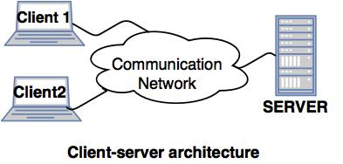
System Architecture

Slide 6
OS CONCEPTS USED
OS CONCEPTS USED
MultiThreading
Sockets & Shared Memory
File System Managment
Synchronization(Sempahores & Mutex)
Encryption

Slide 7

04
03
Develop Q&A Functionalities
05
Implement Multithreading for Multiple Users
Integrate Sentiment Analysis for Answers
02
06
Implement Credit/Rating System
Develop User Authentication
PROJECT
TIMELINE
01
07
1. Set Up the Environment
Develop Feedback Collection & Testing

Slide 8
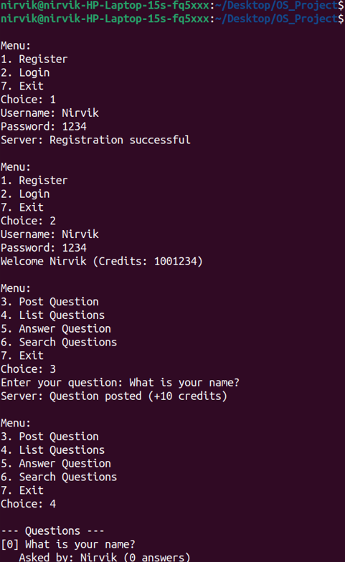
USER INTERFACE

Slide 9

Technical Tools
1.Programming Languages: C , C++
2.Networking: Socket API, TCP/IP
3.Data Storage: File-based storage
4.Cryptography: SHA-256
5.Threading : Pthreads
6. Operating System: Unix-like
7.Compiler: GCC , G++
Notes:
Socket API- Enables network communication between devices- Creates a socket for data transfer- Allows binding, listening, accepting, sending, and receiving dataTCP/IP- Suite of protocols for internet communication- Ensures reliable data transfer (TCP) or best-effort delivery (UDP)- Routes data between devices on different networks (IP)
7

Slide 10
Application
Education: Online learning platforms, educational institutions, and universities can use this platform for students to ask questions and receive answers from instructors or peers.
Customer Support: Companies can implement this platform to provide customer support, allowing customers to ask questions and receive answers from support agents.
Knowledge Sharing: Organizations can use this platform to facilitate knowledge sharing among employees, experts, or community members.
4. Research and Development: Researchers can utilize this platform to ask questions, share findings, and collaborate with peers.
5. Community Forums: Online communities, forums, and social media platforms can integrate this Q&A system to enhance user engagement and knowledge sharing.
6. Healthcare: Patients can ask health-related questions, and medical professionals can provide answers and guidance.
7. Corporate Training: Companies can use this platform to provide training and support to employees, helping them to upskill and reskill.

Slide 11
Expanding Horizons:
Future Envisions for the Q&A System
AI-Powered Answer Ranking: Integrate machine learning algorithms to rank answers based on relevance, accuracy, and user feedback.
Personalized Learning Paths: Develop a recommendation engine that suggests relevant questions and answers based on users' learning history and preferences.
Multimedia Support: Enhance the platform to support multimedia content, such as videos, podcasts, and images, to make learning more engaging and interactive.
Gamification and Incentives: Introduce gamification elements, such as badges, points, and leaderboards, to encourage user participation and engagement.
Global Knowledge Sharing: Develop a multilingual platform to facilitate knowledge sharing across geographical boundaries and cultural differences.

Slide 12
Modular Level Design

Slide 13

Essential Header Files and Macros in client.c
Header Files
Macros
Standard libraries included typically cover network communication (sys/socket.h), input-output operations (stdio.h), string handling (string.h), and system types and calls (unistd.h, arpa/inet.h).
Macros define constants such as port numbers and buffer sizes, ensuring consistency and easier maintenance. For example, they may set a standard buffer size for all message exchanges or error codes for socket operations.

Slide 14
Core Functions in client.c
print_menu(int authenticated)
display_questions(const char *buffer)
display_search_results(const char *buffer)
Displays the client’s menu, modifying available options based on the user's authentication state. It ensures only authorized commands are shown post-login, improving security and user experience.
Processes and visualizes a list of questions retrieved from the server. It parses the buffer containing questions and formats them for user-friendly output, essential for browsing or selecting questions.
Shows filtered questions or answers from search queries. This function highlights relevant results, allowing efficient user navigation through large datasets.

Slide 15

Socket Creation and Communication Setup
1
Socket Creation
Involves using the socket() system call to establish an endpoint for communication. Parameters define the address family, socket type, and protocol. Error handling is critical here to ensure robustness.
2
Server Address Setup
Uses a sockaddr_in structure to specify IP address and port. The client populates this structure to target the server, enabling proper routing of messages.
3
Connection Establishment
The connect() call initiates the connection to the server. It must manage potential failures and retries to assure stable communication.

Slide 16
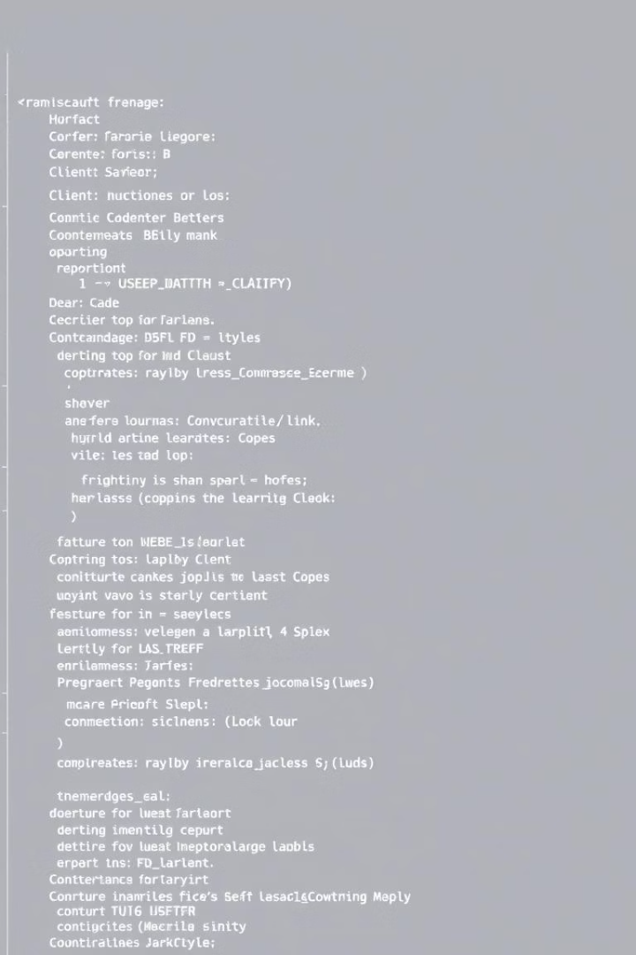
User Interaction: Menu Options Explained
1
Register
Allows new users to create accounts by providing credentials, initiating server-side validation and storage.
2
Login
Users authenticate to access advanced features and post or answer questions. Successful authentication adjusts menu options.
3
Post a Question
Enables logged-in users to submit questions to the server, which are then broadcast or stored for community interactions.
4
List Questions
Retrieves a current list of questions from the server, enabling browsing and selection for answers or details.

Slide 17

Advanced User Operations in client.c
1
Answer a Question
Submits answers tied to specific questions, requiring context management to associate input properly.
2
Search Question
Allows users to query the database with keywords. The implementation efficiently filters and returns matching questions or answers.
3
Rate an Answer
Users can provide feedback or ratings on answers, forming a leaderboard or trust metric for contributors.
4
View Leaderboard
Displays top-rated users or answers, encouraging engagement and highlighting contributors.

Slide 18
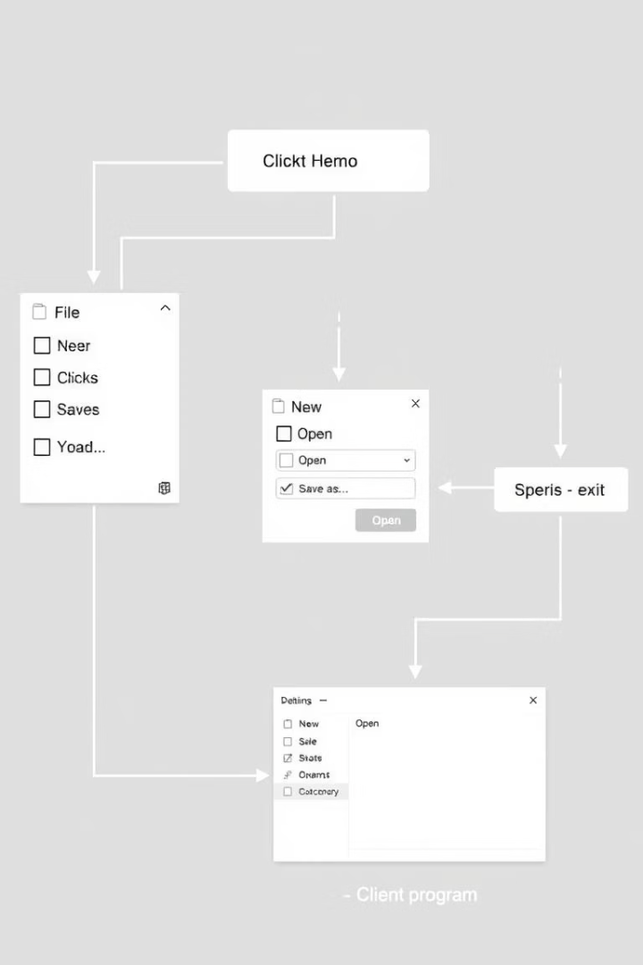




Menu Flow and Interaction Logic
Authentication Check
Menu adapts dynamically based on user authentication status. Unauthenticated users see limited options to encourage login or register first.
Command Input
User inputs a command number corresponding to menu options, triggering associated function calls for processing.
Server Communication
Inputs send requests to the server socket; responses received populate respective display functions to show updated content.
Exit Handling
Logical termination with clean socket closure and resource deallocation ensures program stability and data integrity.

Slide 19
Core Data Structures for Users and Questions
User Structure
Question Structure
Stores user information critical for authentication and authorization.
Captures question details and their associated answers and metadata.
char username[50]: User login identifier
char question[256]: The question text
char password_hash[65]: SHA-256 hash of password in hex
char author[50]: Author of the question
char answers[MAX_ANSWERS][256]: Array of answers
int credits: User points or currency
char answer_authors[MAX_ANSWERS][50]: Corresponding answer authors
int is_manager: Boolean flag for managerial privileges
int score: Aggregated user performance metric
int answer_count: Number of answers submitted
int ratings[MAX_ANSWERS]: Ratings for each answer

Slide 20
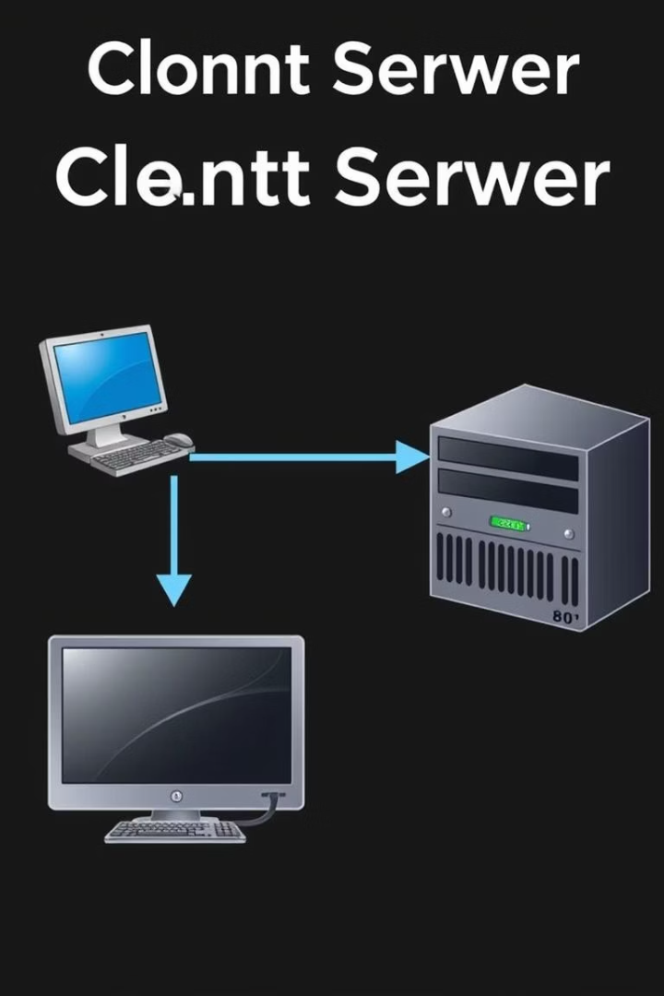
Session Management with ClientSession Structure
The ClientSession structure manages individual client connections and session states, facilitating concurrent client handling.
Socket and Address
User Linkage
int sock: TCP socket descriptor for communication with the client; struct sockaddr_in addr: client's network address.
int user_idx: Index link to the users array, establishing the logged-in user context.
Authentication Status
int authenticated: Flag indicating if the user has successfully authenticated in this session.

Slide 21

Password Hashing and Data Persistence Functions
hash_password()
Performs SHA-256 hashing of plaintext passwords and outputs the result as a hexadecimal string, guaranteeing secure storage.
load_data()
Executes loading of persistent data from disk files (users.dat and questions.dat) into active memory arrays for runtime operations.
save_users() and save_questions()
Safely persist current in-memory user and question data back to their respective storage files to maintain data integrity and recovery.

Slide 22
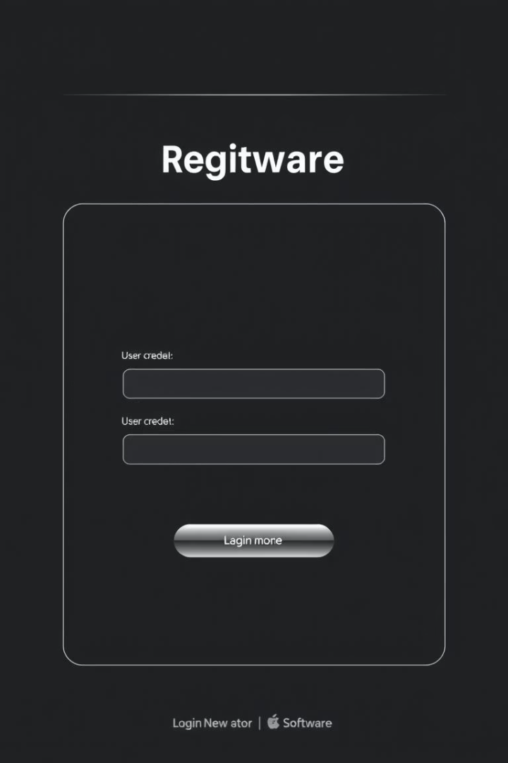
User Management Commands and Logic
REGISTER
1
REGISTER
2
LOGIN
Registers a new account by accepting username and plaintext password, creates a hashed password, and adds user to storage.
Authenticates existing users by comparing the input password hash with stored credentials, setting session state upon success.
3
LOGOUT
Terminates the user's session and clears authentication flags for security and resource cleanup.

Slide 23
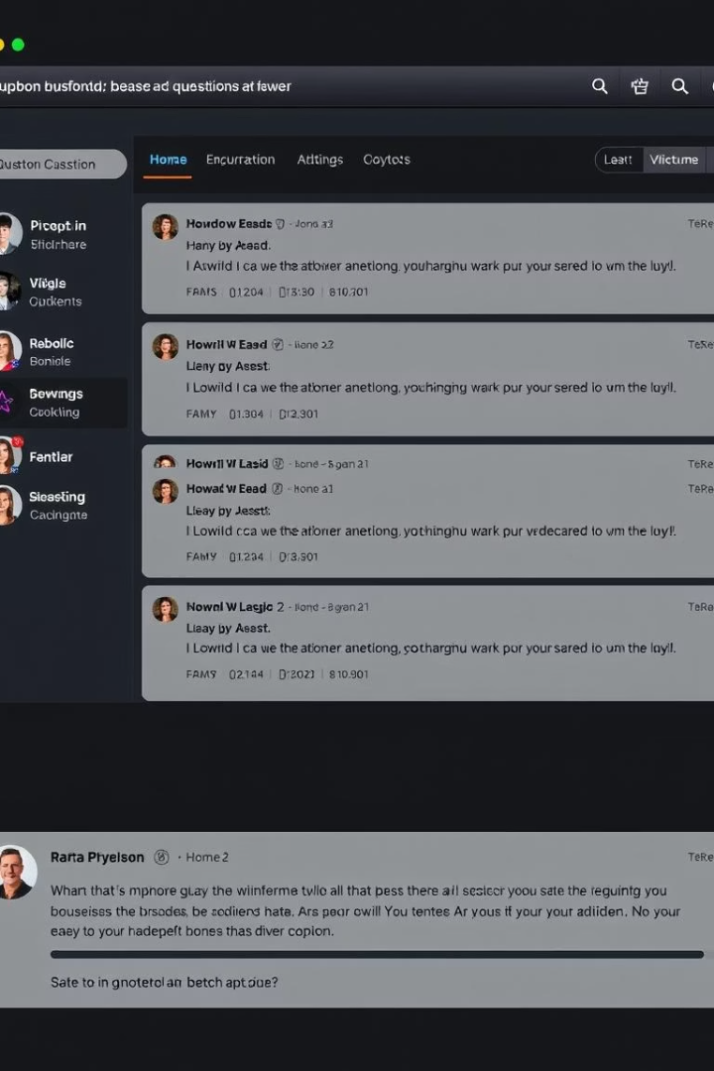




Question Management and Interaction Commands
POST
Users submit new questions to the system with textual content.
LISTQ
Enumerates all stored questions for users to view and pick for interaction.
ANSWER
Allows users to answer specific questions by index with textual responses.
RATE
Users rate answers on questions, contributing to answer quality metrics.

Slide 24
Search, Leaderboard, and Networking Commands
SEARCH
LEADER
Networking Command Processing
Enables keyword querying within stored questions for efficient information discovery.
Displays a leaderboard ranking users based on scores or credits, motivating engagement.
The server parses and executes commands sent over TCP sockets, managing concurrent client interactions inline with protocol definitions.

Slide 25
PROJECT RESPONSIBILITY
SYSTEM DESIGN
A
Devansh Srivastava
Pranjal Singh
PROJECT PLANNING
B
Sagar Bejawada Ritesh Kumar Yadav
CODING
C
Ayush Anand Nirvik Jana Devansh Srivastava
PPT DESIGN
D
Subhamita Halder Shaswat Ranjan
UI INTERFACING
E
Aditya Pratap Singh Syamantak Banerjee
RESOURCE MANAGMENT
F
Kunal Singh Munda Ritesh Kumar Yadav

Slide 26

Thank You !!

